Slide 1




A Survey on Stance Detection
for Mis- and Disinformation Identification
Momchil Hardalov,^{1,2} Arnav Arora,^{1,3} Preslav Nakov,^{1,4} Isabelle Augenstein^{1,3}
¹Checkstep Research ²Sofia University "St. Kliment Ohridski" ³University of Copenhagen ⁴Qatar Computing Research Institute, HBKU
The 2022 Annual Conference of the North American Chapter of the Association for Computational Linguistics (NAACL 2022)

Slide 2
Motivation
Rapid Growth in Popularity of Social Media Platforms
Led to a flood of dubious content, especially during controversial events
COVID-19 gave rise to the first global infodemic

Slide 3
Motivation
Rapid Growth in Popularity of Social Media Platforms
Led to a flood of dubious content, especially during controversial events
COVID-19 gave rise to the first global infodemic
Need for Effective Mis- and Disinformation Identification Online
Fact-checkers/journalists need tools to assess the veracity and the factuality of online content
The wisdom of the crowd can help for detecting rumours, hoaxes, fake news, etc.

Slide 4
Motivation
Rapid Growth in Popularity of Social Media Platforms
Led to a flood of dubious content, especially during controversial events
COVID-19 gave rise to the first global infodemic
Need for Effective Mis- and Disinformation Identification Online
Fact-checkers/journalists need tools to assess the veracity and the factuality of online content
The wisdom of the crowd can help for detecting rumours, hoaxes, fake news, etc.
Automatically Detecting False Information Online w/ Stance Detection
Stance detection can be a powerful tool for detecting false information
No existing holistic overview of stance detection for false content identification

Slide 5

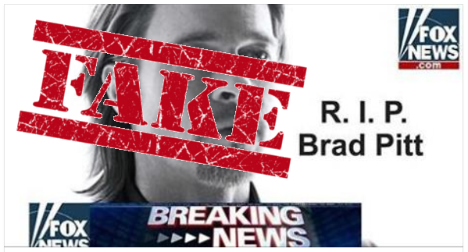
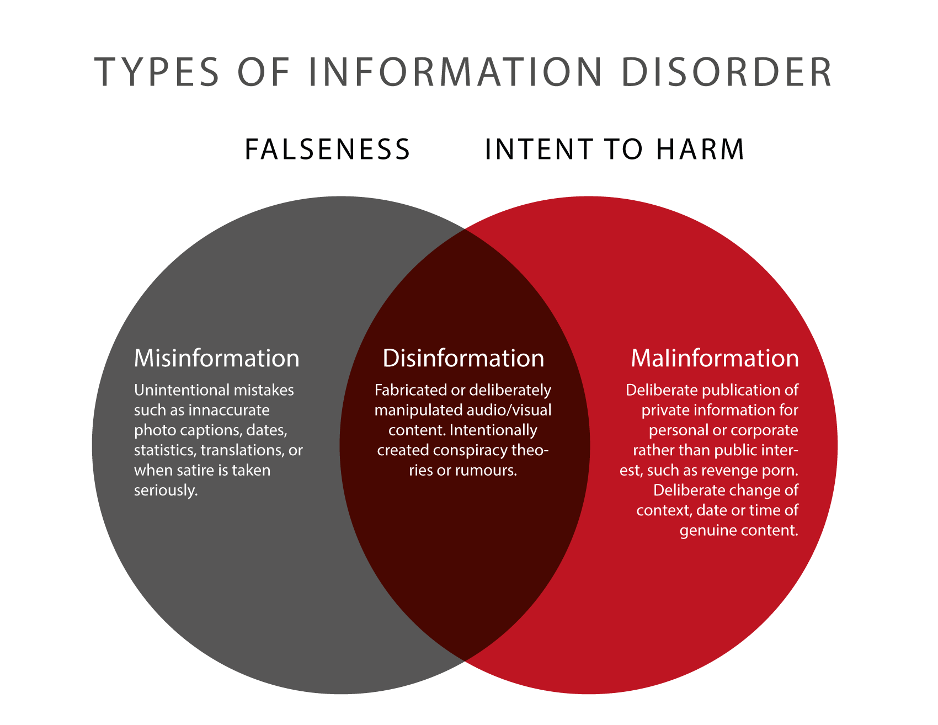




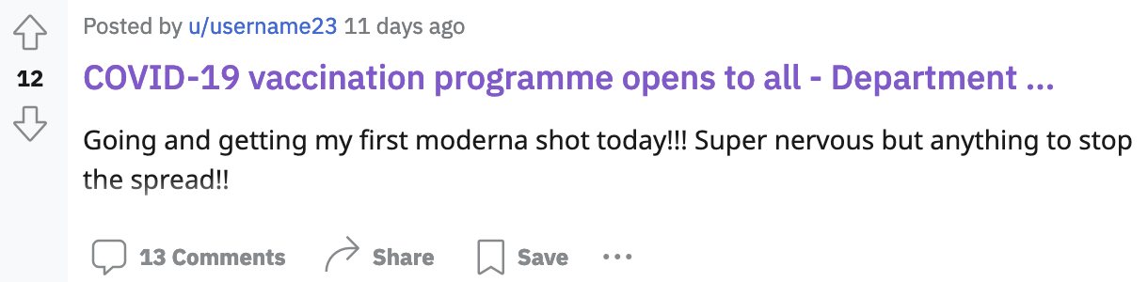


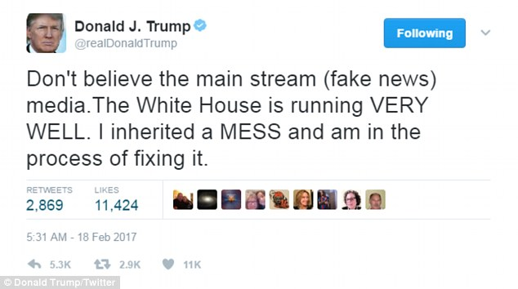
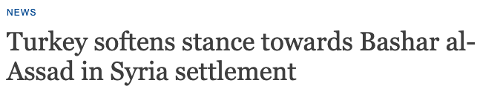

Stance Detection and Mis- and Disinformation
In this survey
Not included
[1] https://firstdraftnews.org/wp-content/uploads/2018/07/ Types-of-Information-Disorder-Venn-Diagram.png

Slide 6
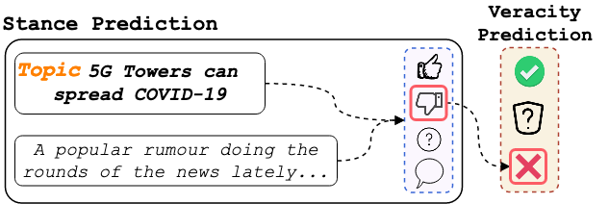
Stance Detection as Fact-Checking

Slide 7
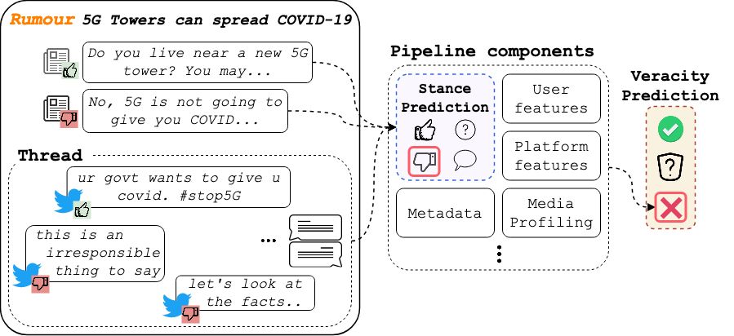
Stance Detection as Part of a Fact-Checking Pipeline

Slide 8
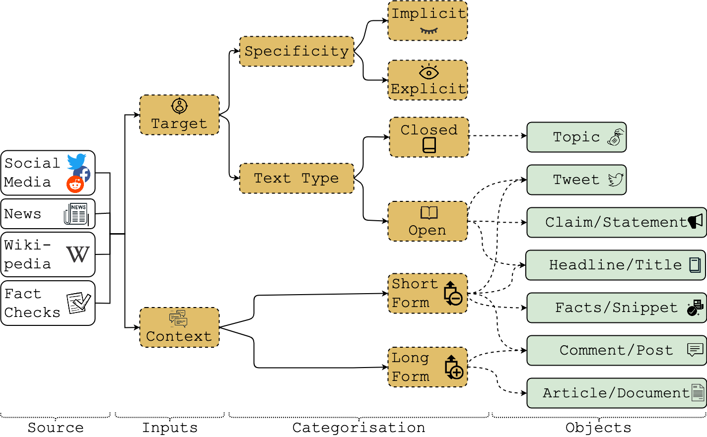
Types of Stance Settings

Slide 9

Lessons Learned and Future Trend
Dataset Size
A major limitation when training models
The vast majority of datasets contain just a few thousand examples

Slide 10

Lessons Learned and Future Trend
Dataset Size
A major limitation when training models
The vast majority of datasets contain just a few thousand examples
Data Mixing
Can compensate for small dataset sizes
Not trivial, task definitions and label inventories vary across datasets

Slide 11

Lessons Learned and Future Trend
Multilinguality
Currently, only a handful of multilingual datasets exist
Small in size and do not offer cross-lingual setups (X-Stance is an exception)
Cultural norms play a crucial role

Slide 12

Lessons Learned and Future Trend
Multilinguality
Currently, only a handful of multilingual datasets exist
Small in size and do not offer cross-lingual setups (X-Stance is an exception)
Cultural norms play a crucial role
Modelling the context
Background of the stance-taker, e.g., previous activity, network, interests
Characteristics of the target, e.g., funding, previously known biases, credibility

Slide 13

Lessons Learned and Future Trend
Multimodal content
Spreading mis- and disinformation through multiple modalities is becoming increasingly popular (e.g., deepfakes, memetic warfare)
The wisdom of the crowd in social media can be an additional information source

Slide 14

Lessons Learned and Future Trend
Multimodal content
Spreading mis- and disinformation through multiple modalities is becoming increasingly popular (e.g., deepfakes, memetic warfare)
The wisdom of the crowd in social media can be an additional information source
Shades of truth
Missing notion in stance detection, but fact-checking goes beyond true/false
Fine-grained labels are common for the related task of Sentiment Analysis

Slide 15

Lessons Learned and Future Trend
Label Semantics
With time, the stance task definition and the label inventories have evolved
The labels can share semantic similarities, but there can be mismatches in the label definitions

Slide 16

Lessons Learned and Future Trend
Label Semantics
With time, the stance task definition and the label inventories have evolved
The labels can share semantic similarities, but there can be mismatches in the label definitions
Explainability
A crucial step towards adopting fully automated fact-checking
There is a need for holistic and realistic explanations of how a fact-checking model arrived at its prediction

Slide 17
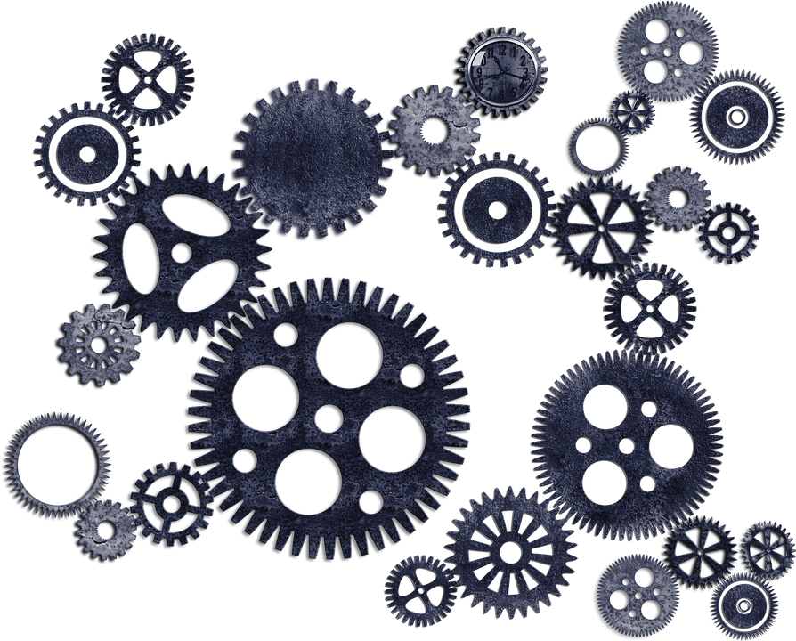
Lessons Learned and Future Trend
We argue that a tighter integration between stance and fact-checking is needed
Integration

Slide 18
Summary
Holistic overview of the role that different formulations of stance detection play in the detection of false content
Settings for mis- and disinformation identification to which stance detection has been successfully applied: datasets and task formulations
Current state-of-the-art approaches, systems and applications of stance detection for mis- and disinformation identification
Lessons learned and key future trends

Slide 19
Thank You for Listening!
Please check out our paper for more details: “A Survey on Stance Detection for Mis- and Disinformation Identification”
If you have more questions, please contact hardalov@fmi.uni-sofia.com

